Slide 1
Scenario 4: AR Mobile App Overlays Virtual Objects on Real Scenes
Presented By
P.Divakaran(192424260)
DSA0202-Comuter Vision
Guided By
Dr.MAYURANATHAN M

Slide 2
AR Mobile App Overlays Virtual Objects on Real Scenes
AR Mobile stands for Augmented Reality Mobile.
It is a mobile application that uses the smartphone's camera to combine real-world views with virtual (digital) objects in real time.
Simple Definition
AR Mobile = Real World + Virtual Objects (using a smartphone camera).
Examples
👓 Snapchat/Instagram Filters – Adds virtual glasses, hats, or masks to your face.
🎮 Pokémon GO – Places Pokémon in your real surroundings.
📷 Mobile Camera
↓
Detects Real World
↓
Computer Vision
↓
Computer Graphics
↓
📱 AR Display
(Real Scene + Virtual Object)

Slide 3
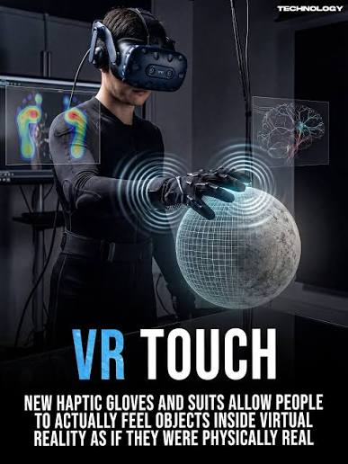
Virtual Objects
Virtual Objects are computer-generated (digital) objects that do not physically exist but appear on a screen or in an AR/VR environment.
Simple Definition
Virtual objects are digital 2D or 3D objects created by a computer and displayed on a real-world scene or in a virtual environment.
Examples
👓 Virtual glasses on your face (Snapchat filter)
🪑 A virtual chair placed in your room (IKEA Place)

Slide 4
Scenario 4: AR Mobile App Overlays Virtual Objects on Real Scenes
A. Difference between Computer Graphics and Computer Vision
Computer Graphics | Computer Vision
Creates virtual objects and 3D models. | Understands and analyzes real-world images.
Output: Synthetic images. | Output: Object/face detection and recognition.
Example: AR furniture, game characters. | Example: Face detection, object tracking.

Slide 5
📷 Camera
│
▼
🌄 Capture Scene
│
▼
📐 Camera Model
│
▼
🎨 Render Virtual Object
│
▼
📱 AR Display
B. Camera Model Usage
The camera model is used to:
📷 Capture the real-world scene.
📍 Estimate camera position and orientation.
🎯 Align virtual objects with the real scene.
🔄 Ensure accurate AR object placement.

Slide 6
C. Real-Time Challenges
⚡ Fast image processing (low latency)
🎯 Accurate object/feature tracking
💡 Handling changing lighting conditions
📷 Camera motion and blur
🔋 Limited mobile CPU, GPU, and battery
🧩 Maintaining stable AR object placement

